Slide 1
Divisions:
Christ Above All Cost (Matthew 14:1-12)
Christ Above All Need (Matthew 14:13-21)
Christ Above All Fear (Matthew 14:22-36)

Slide 2
Turn Your Eyes Upon Jesus
O soul are you weary and troubled?
No light in the darkness you see?
There’s light for a look at the Savior
And life more abundant and free
Turn your eyes upon Jesus
Look full in His wonderful face
And the things of earth will grow strangely dim
In the light of His glory and grace

Slide 3
Verse 2
Through death into life everlasting
He passed and we follow Him there
Over us sin no more hath dominion
For more than conqu’rors we are
Turn your eyes upon Jesus
Look full in His wonderful face
And the things of earth will grow strangely dim
In the light of His glory and grace

Slide 4
Verse 3
His Word shall not fail you He promised
Believe Him and all will be well
Then go to a world that is dying
His perfect salvation to tell
Turn your eyes upon Jesus
Look full in His wonderful face
And the things of earth will grow strangely dim
In the light of His glory and grace

Slide 5
Divisions:
Christ Above All Cost (Matthew 14:1-12)
Christ Above All Need (Matthew 14:13-21)
Christ Above All Fear (Matthew 14:22-36)

Slide 6
Principles:
Following Christ may cost everything.

Slide 7
Principles:
Following Christ may cost everything.
Christ faithfully satisfies our every need.

Slide 8
Principles:
Following Christ may cost everything.
Christ faithfully satisfies our every need.
Focus on Christ overcomes all fear.

Slide 9


Slide 10


Slide 11
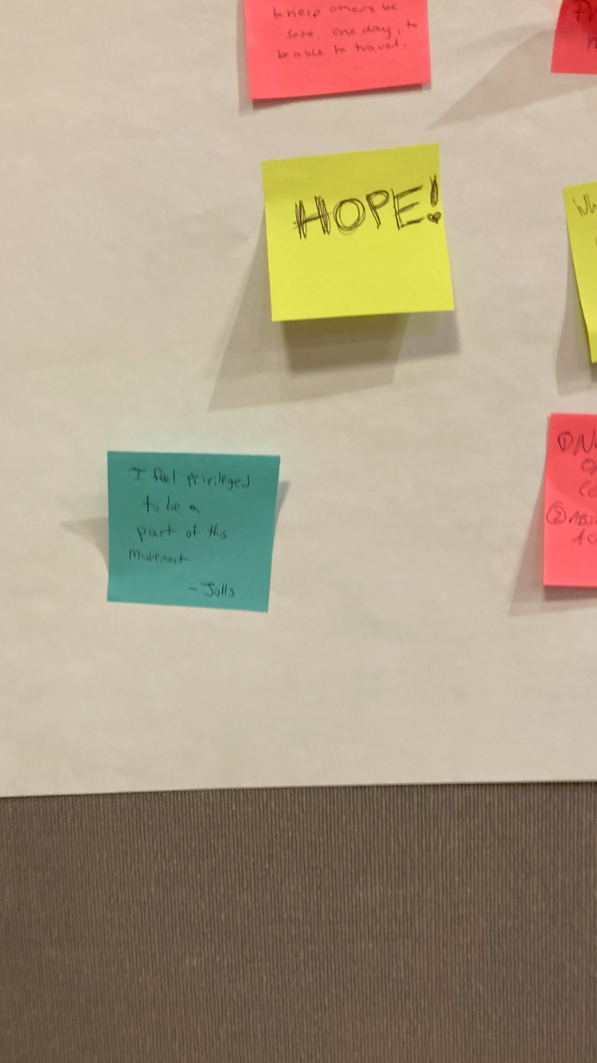

Slide 12
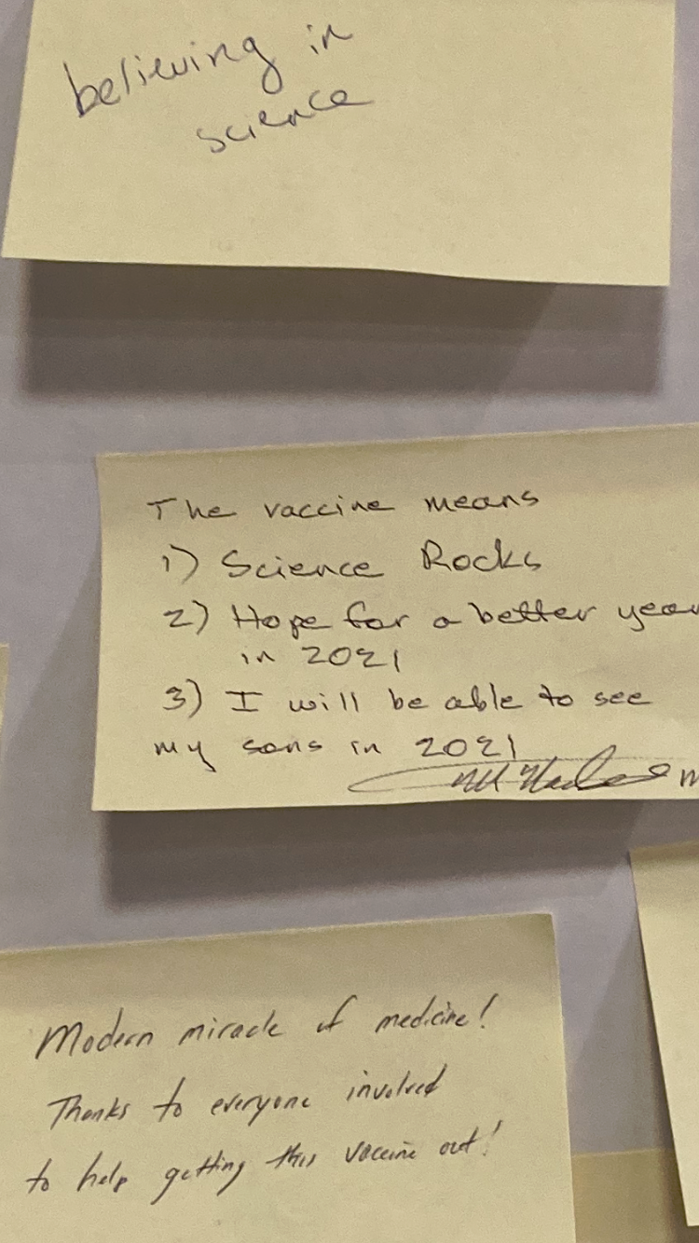

Slide 13
